Slide 1
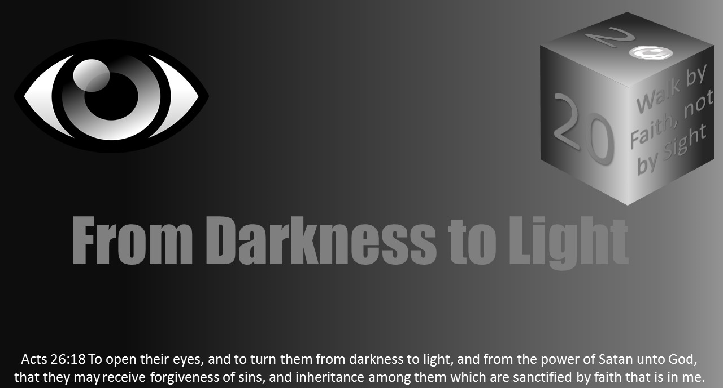


Slide 2
Light Lesson 17 Walking as Children of Light

Slide 3
Ephesians 5:1-14 ESV
Therefore be imitators of God, as beloved children. 2 And walk in love, as Christ loved us and gave himself up for us, a fragrant offering and sacrifice to God. 3 But sexual immorality and all impurity or covetousness must not even be named among you, as is proper among saints. 4 Let there be no filthiness nor foolish talk nor crude joking, which are out of place, but instead let there be thanksgiving. 5 For you may be sure of this, that everyone who is sexually immoral or impure, or who is covetous (that is, an idolater), has no inheritance in the kingdom of Christ and God. 6 Let no one deceive you with empty words, for because of these things the wrath of God comes upon the sons of disobedience. 7 Therefore do not become partners with them; 8 for ^{b}at one time you were darkness, but now you are light in the Lord. Walk as children of light 9 (for the fruit of light is found in all that is good and right and true), 10 and ^{f}ry to discern what is pleasing to the Lord. 11 Take no part in the unfruitful works of darkness, but instead expose them. 12 For ^{k}it is shameful even to speak of the things that they do in secret. 13 But when anything is exposed by the light, it becomes visible, 14 for anything that becomes visible is light. Therefore it says, “Awake, O sleeper, and arise from the dead, and Christ will shine on you.”

Slide 4
Introduction
To become children of light, our first observation should be in Ephesians 5:8-10. “…For at one time you were darkness, but now you are light in the Lord. Walk as children of light. (for the fruit of light is found in all that is good and right and true), and try to discern what is pleasing to the Lord.”
What is there in that passage which stands primary to your walk in life?

Slide 5
Introduction
We do not have trouble walking in the light.
It is walking in the dark which troubles us most, because we cannot see where we are going.
If we are used to walking in a particular place in the light, we still have trouble walking in the dark.
As a result, we put light in a parking lot. We put a “night-light” in a hallway.
We want to see where we walk at night.
Beloved, as Christians, we are children of night-light, because we live in a world where people love darkness (John 3:19-21).

Slide 6

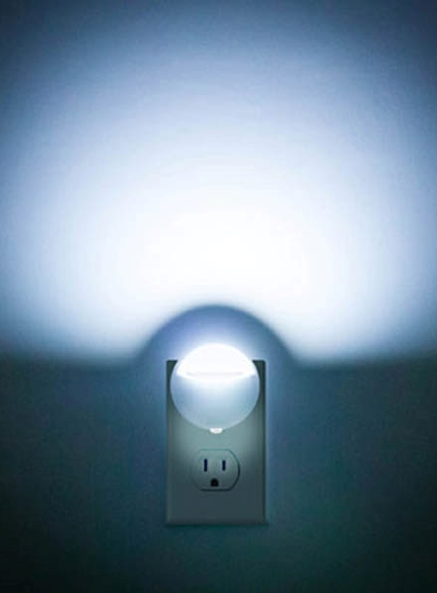
Introduction
Let’s understand something very basic. Light and Dark are so, so, so opposite.
We know and can tell the difference.
As Christians in the world, we are so, so, so opposite that of the character of the world.
At times the distinction is not so clear, and the color we illuminate looks more like gray.

Slide 7
Introduction
Being gray or in the middle is a place some would rather be than the extreme of light or dark.
We often think to make a difference, you have to abide by 1 Corinthians 9:22: “I am become all things to all men, that I may by all means save some.”
That passage is pulled completely out of context in an effort to minimize the difference in believers and unbelievers.
We say they are “good people” and fail to speak truth lest it becomes offensive. We blend and become gray and neither white or black (i.e., light or dark).

Slide 8
Introduction
The other idea we have is to never come in contact with the world.
We are too pure. We are too good to get mixed up in all this ‘trash.”
The world has so much darkness and immorality, we refuse to be as Jesus exhorted the apostles in John 17:15-18 and as Paul said to Christians at Corinth in 1 Corinthians 5:9 to be a light and impact those who are unbelievers to be children of light.
Where does a Christian draw the line in a dark world to become light and make a difference for good as the light of the world?

Slide 9
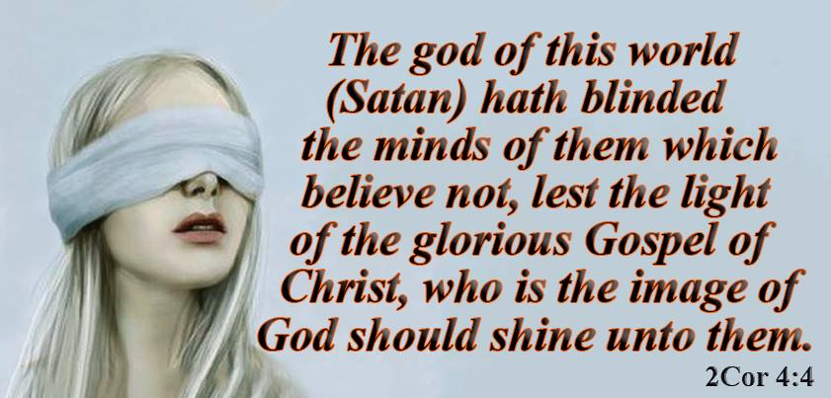
Introduction
In 2 Corinthians 4:3-5, Satan is the one blinding the gospel, not only to the unbelieving, but also the believer.
Satan wants the dark and the gray to appear in our minds, not the light.
If the gospel comes out, it shows the true color of him and sin - BLACK.
In v.6 lies the responsibility of the Christian, “light shall shine out of darkness.”
God looks for those He brought from the darkness to light to shine and be children of light.
As 1 Thessalonians 5:5 says, “For you are all children of light, children of the day. We are not of the night or of the darkness.”

Slide 10
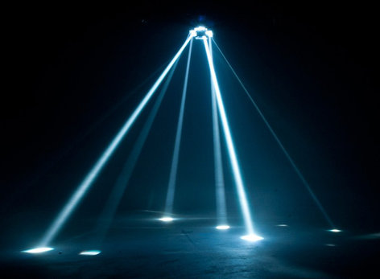
Be Imitators of God - Ephesians 5:1
As God’s children, imitating God should be a passion, because we are born of Him.
As 1 John 1:5-7 says, “God is light, in him is no darkness at all…walk in the light, as he is in the light.” If we decide to walk in darkness while calling our self a child of God, a child of light, we are A LIAR.
Carefully understand this! God is the illumination of His children. This allows us the privilege to illuminate. Without God, there is no light.
What one thing could you do for God to display His illumination in the world?

Slide 11
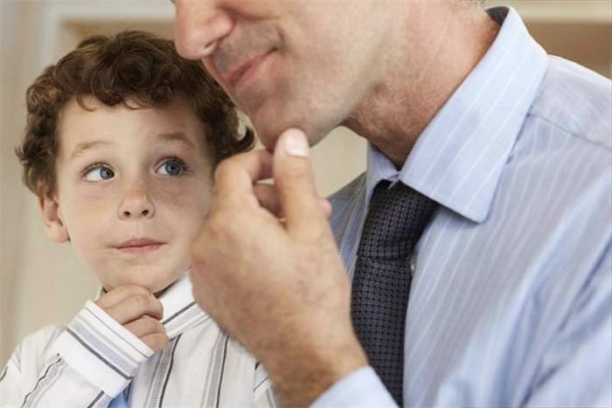
Be Imitators of God - Ephesians 5:1
Children illuminate everything about their parents. This is a serious matter.
Children tell the truth about everything their parents do;
what they will and will not let them do;
if they are loving or hateful;
if they are caring or do not care;
if they are firm or indifferent.

Slide 12
Be Imitators of God - Ephesians 5:1
In many ways, children carry a reflection of their parents everywhere they go.
Parents may think many of the problems a child has comes from their teacher, friends, TV, or environment.
It is really a child’s exposure to their parents is why thy child becomes who they are, which is either light or darkness.
In the same fashion, what we do is showing people who God is to us.

Slide 13
Be Imitators of God - Ephesians 5:1
Imitate God. Walk in love as Christ loved. Forgive. Do not participate in filthiness.
The most significant point to consider here is being like God is attainable.
We are not speaking of perfection. We are talking character, nature, and identity.
Who are you? Define who you are to someone?
Are you born of God of the water and the spirit?
Will those who see and hear you say I can see you walk like the FATHER - God?

Slide 14
Our Light Depends Upon Our Exposure to God
The more exposure to the light (God), the more we are children of light.
We emit His glory because of our constant, diligent exposure to Him.
The opposite is true as well.
The less we allow our self to be exposed to God, the less light and the greater the darkness is within us.

Slide 15
Our Light Depends Upon Our Exposure to God
Some children grow up in life and have NO FATHER who lives with them.
They are born of a father but are never exposed to him.
Some are exposed every other weekend.
Some see a father on holidays.
Other children never hear or know who their father is.
The absence of a father is what 15 million children in the U.S. experience (1 out of 3 children).
Almost 40% of children 1st - 12th grade have no father at home.
The problem is fathers voluntarily abandon their children.
What do you believe the impact is of a child living in a fatherless home?

Slide 16

Our Light Depends Upon Our Exposure to God
Having a fatherless home, “It is the engine driving many social problems in our society” (David Blankenhorn).
Those without a father are 63% of youth suicides (5x the average);
90% of homeless/ runaway children;
85% of childhood behavioral problems (20x the average);
80% of rapists & anger problems;
71% of high school dropouts;
85% of youths in prison;
Greater levels of aggression among boys;
Lower average income level;
Greater use of drugs & alcohol;
Increased rates of relationship problems.

Slide 17
Our Light Depends Upon Our Exposure to God
The reason for the above information shows us on a social level the more exposure to a father
the less likelihood of sin,
social problems,
better achievement,
and behavior.
Spiritually identical to this is the more light we shine depends upon our exposure to God.
What places and what means do Christians have to be exposed to God versus the choice of being exposed to the dark world?

Slide 18
Our Light Depends Upon Our Exposure to God
Matthew 5:14, 16 speaks to disciples as being light to bring the vision of glory to God to the hearts of others.
That is not possible when you are not exposed to His light always.
Glory never comes to God if all we ever receive from God is a once a week morsel of a taste of the righteousness of God.
A Christian may speak with pride of the church is where they worship, but the amount of light from a church is determined by how much those in it, His children, are exposed to God, the light.

Slide 19
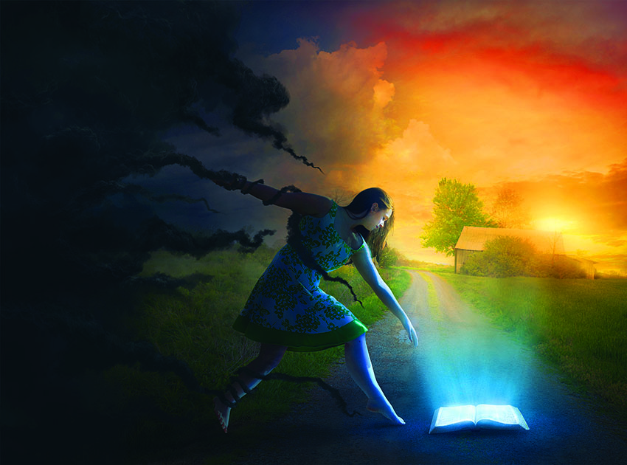
Reprove the Darkness Ephesians 5:11-13
We can imitate God and constantly expose our self to Him, but as a Christian, delivered from the darkness of the world into the kingdom (Col 1:12, 13), we need to reprove the darkness.
Having first been converted to the Lord as a child of light, we may still have a familiar taste with the world and its ways because the world was a part of us (Eph 5:7).
Being a Christian does not negate any pressure to being drawn back into darkness. We will always be pressured to imitate the world in which we live.
We are advertised to, exhorted to, and entertained to be in the darkness as the world is.

Slide 20

Reprove the Darkness Ephesians 5:11-13
People we love and who love us tempt us and want us to do like they do in every way.
The pressure placed upon the Christian is to go back. It was a mistake to deny self. It was a poor choice to be godly.
The great assignment is to go forward, though the battle between darkness and light, flesh and spirit takes place (Gal 5:16, 17).
What can you do as a Christian to prevent yourself from becoming like 2 Peter 2:20-22?

Slide 21
Reprove the Darkness Ephesians 5:11-13
Some Christians would rather silently bemoan the plight of the world and the society in which their children will be raised.
We might speak against what the world does to those already walking in the light, but what are we saying to those who daily live in darkness?
Christians are striving for holiness and should reprove those in darkness with a simple question to the one in sin.
“What chance is there for your life to have full blessings living in darkness?”
What could a Christian say to one living in darkness for them to see the richness of spiritual blessings?

Slide 22
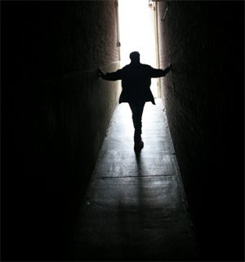
Reprove the Darkness Ephesians 5:11-13
Christians need to know if they expose the darkness of sin, the reproved sin may continue.
Yet it does not prevent us from exposing sin the next time.
We can no longer be silent.
We should speak truth in a culture who redefines sex, marriage, and the meaning of right and wrong.

Slide 23
Reprove the Darkness Ephesians 5:11-13
The Christian in the light is to “expose” evil for what it is. Sin is awfulness.
Silence may encourage, which increases the chance this immoral attitude or action continues.
It is not only by saying, “I wish you would not say or do that in my presence,” but show the truth of what God says about such action and what actions God accepts and favors.
2 Timothy 4:2 says “preach the word, be urgent in season, out of season…”
Truth may be appreciated. It may not. It may not be liked, yet the reproving of sin is our responsibility as children of light.

Slide 24
Reprove the Darkness Ephesians 5:11-13
In the midst of reproving, a Christian can show as children of light the opposite of what the world would do.
They are selfish, but we are giving.
They curse; we bless.
They live for self; we live for God and others.
They lie; we speak the truth.
The point is children of light, who take sin seriously by being saved, need not wink at it, laugh at it, or say “I’m glad I stopped doing that.”
Confront the sin, whether it is or is not the same sin in which you engaged.
It is not that you are eager to hear of the sins of others. We share the truth to expose the shame to bring the soul to Jesus Christ. Reprove it. Do not gossip about it. Hold up scripture as the pattern of life for all men/women, because showing the scripture places the light upon God not upon you.

Slide 25
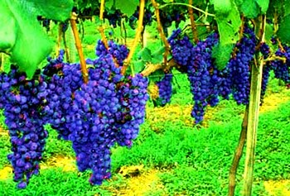
Bear the Fruit of Children of Light Ephesians 5:9,10
This passage is an evidence producer and reality of those who are children of light.
Christians are to be fruit bearers like Galatians 5:22, 23 says.
Changed people lived changed lives.
Those who lived the light producing changed life are examples of the following.

Slide 26
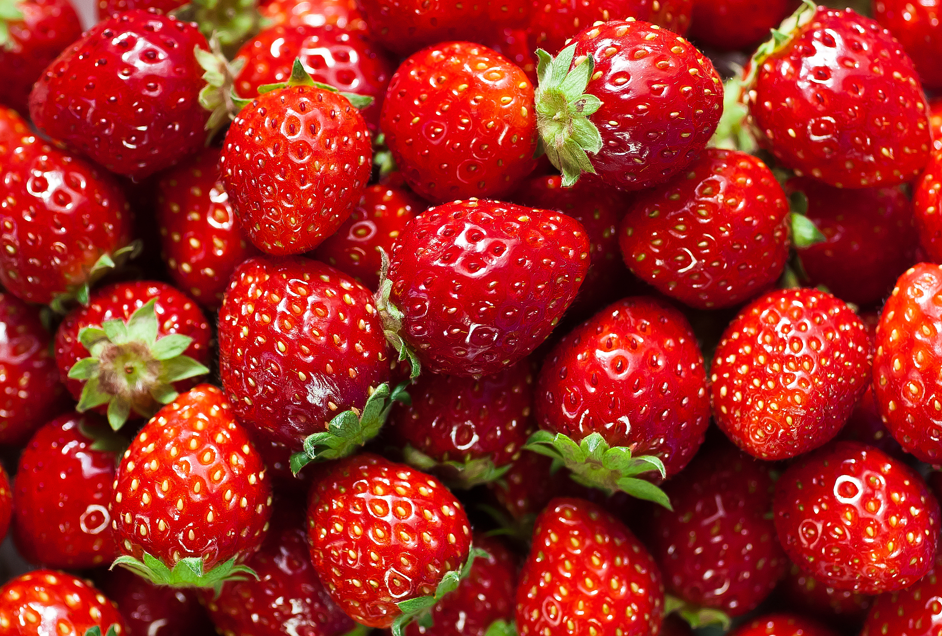
Bear the Fruit of Children of Light Ephesians 5:9,10
“Goodness” - This is the “uprightness of heart and life.”
As we would speak of God as good, this speaks of godliness in the motives, thoughts, and actions of children of light.
Goodness is a definite godly trait.
It is not only speaking of God as good, and what He says as good.
Goodness in children of light will catch the attention of others as kind, loving, caring, helping, and serving.

Slide 27
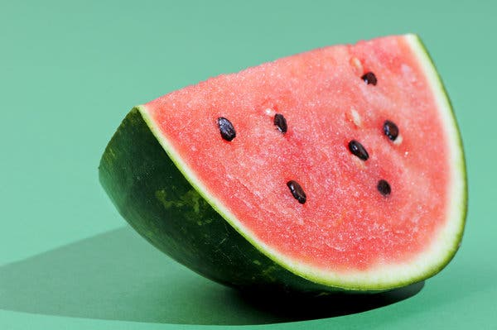
Bear the Fruit of Children of Light - Ephesians 5:9,10
“Righteousness” - This word is where a child of light stands.
We walk and live on the path of right, because our salvation made us right, and we are constantly loyal and honest to what is right (Titus 2:11, 12).
Right is who we are.
Righteousness is what we have from Christ Jesus who lived righteous (Acts 10:34, 35).

Slide 28
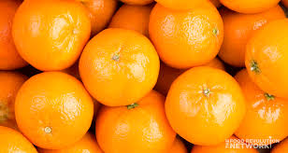
Bear the Fruit of Children of Light - Ephesians 5:9,10
“Truth” - No one is as honest, reliable, and more trusting than children of light.
When these people daily live in the world, the world sees them as a great contrast to the hypocritical, deceptive, and false ways of society.
Let us never be guilty of putting off a false light by telling people one thing but presenting something else.

Slide 29
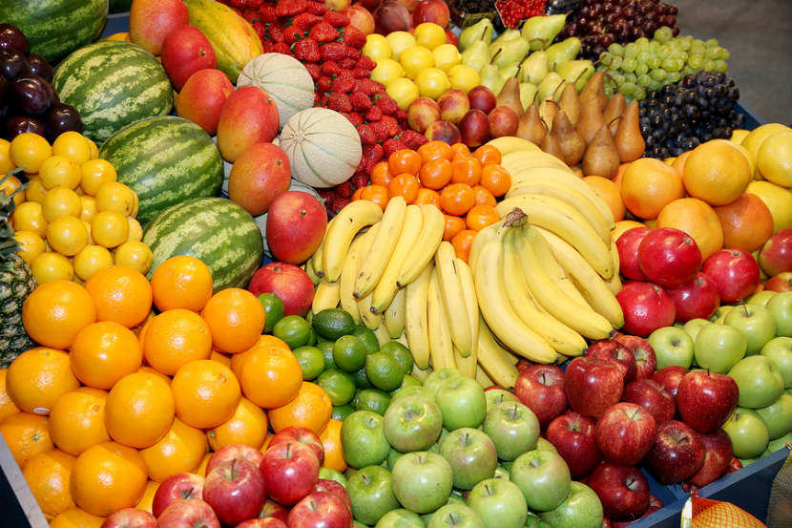
Bear the Fruit of Children of Light - Ephesians 5:9,10
“Goodness” is a matter of our relationship with others.
“Righteousness” deals with our relationship with God.
“Truth” deals with the personal integrity of our own lives.
These three fruits come from children of light.
All these fruits please God because they are just like God (Col 1:9-13).
As children of light who ARE like Him now, we WILL BE like Him in glory! Walking in the light is a choice for today and a choice for the future…

Slide 30


